Slide 1


Show Me the Money
5 Steps to get funding for IT Security

Slide 2

Pssst.. Who is this guy?
Rob Garbee
Technical Security Analyst
20 or so years in IT
Banking, DOD, HIPAA
CISSP
What does all that mean?

Slide 3

I’m Just Like you…
A minion trying to figure it out

Slide 4
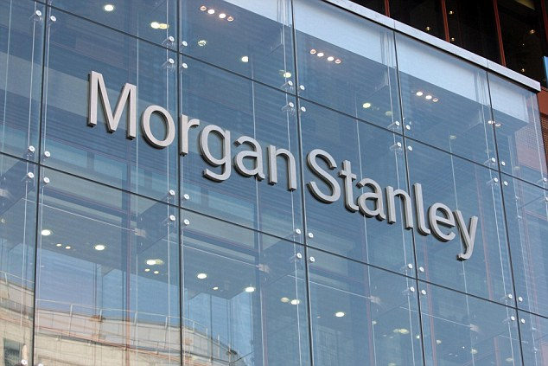


Why do this stuff
Notes:
Advocate
$5.55 Million
Didn’t conduct an accurate and thorough assessment of the potential risks and vulnerabilities to all of its ePHI;
Did not reasonably safeguard an unencrypted laptop when left in an unlocked vehicle overnight.
University of Mississippi Medical Center
2.75 Million
Did not implement appropriate policies and procedures to prevent, detect, contain, and correct security violations;
Did not implement physical safeguards for all workstations that access ePHI to restrict access to authorized users;
$1 Million
Morgan Stanley
The SEC found that MSSB violated Regulation S-P due to its failure to implement sufficient safeguards to protect customer information.

Slide 5
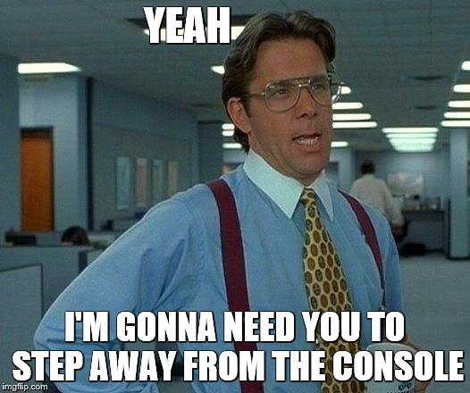
Lets Get Started

Slide 6
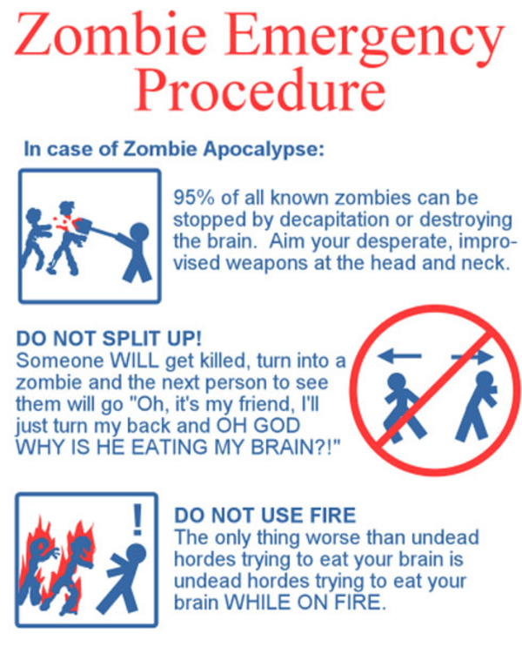
Step 1 - Policies and Procedures
(or whatever you call them)
Are you and your company following them
Do procedures align with policy
Are procedures documented
Identify gaps and document them
Notes:
Policy and procedures
Review your policies and procedures?
Are you and your company following them?
Do procedures align with policy
Are you procedures documented
Where are they stored
Online / Offline
Identify gaps

Slide 7
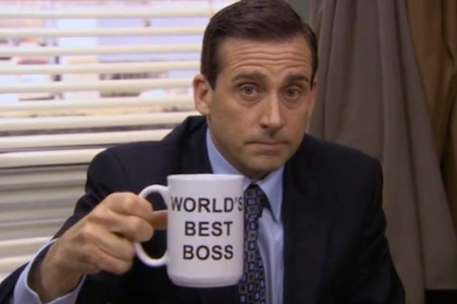

Step 2
Speak to your management team
What keeps them up at night
What are you responsible for
Where is your important data
How much is that data worth
Note these items
Notes:
What keeps them up at night?
What are you responsible for?
Where is your important info?
How much is that data worth?
Seriously what is it worth?
Note these items?

Slide 8
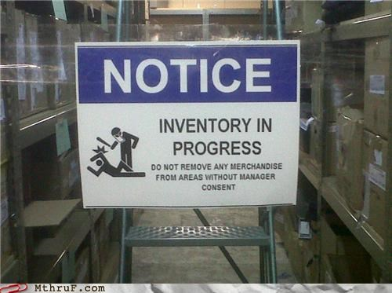
Step 3
Perform an inventory
Where is your stuff
Where is your important data
If you don’t know how can you protect it
Notes:
Where are your assets?
Where does your important data live?
Servers
Laptops
PC's
Printers
BYOD, Phones

Slide 9

Before we move on you should now have the following
STOP
What the important data is
Where the important data lives
How much the important data is worth
Policy discrepancies

Slide 10
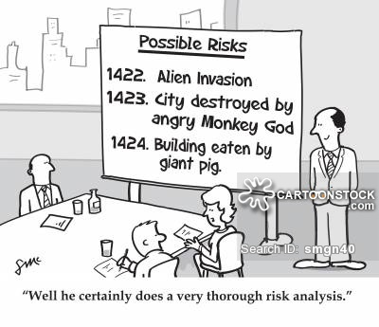
Step 4
Risk Assessment
Use the data you have collected
Logical Risk Assessment
Physical Risk Assessment
Notes:
isk analysis
Use the data that you have collected
Physical risk assessment
Spreadsheet example (template)
Walkthrough
Logical risk assessment
Spreadsheet example (template)
Walkthrough

Slide 11
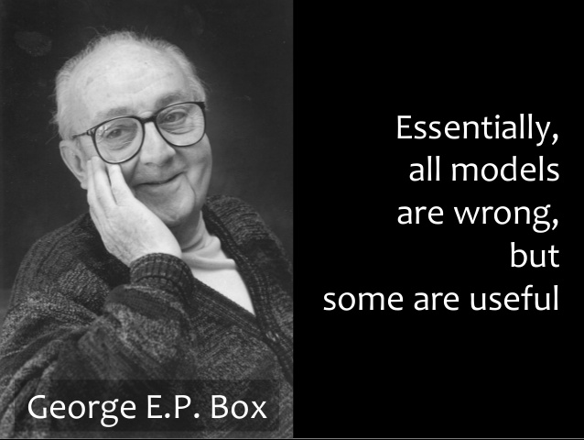
Step 4
Risk Assessment
(British mathematician and professor of statistics at the University of Wisconsin

Slide 12
Step 5
Demonstrate the results
Use the data that you have collected
Hard to argue with their own words
Demonstrate the need by use of monetary loss
Report, PowerPoint, etc.
Notes:
Present your findings
Use the data that you have collected
Hard to argue with their own words
- Policy, etc.
Demonstrate the need by use of monetary loss

Slide 13

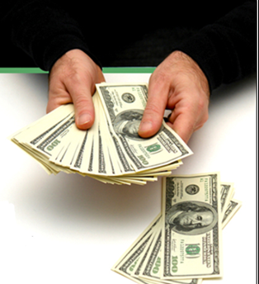

If we have done it right..

Slide 14
Show Me the Money
5 Steps to get funding for IT Security

Slide 15
Additional stuff
Use external resources if needed
Use free tools if needed
  Nessus
  Security Onion
Notes:
Present your findings
Use the data that you have collected
Hard to argue with their own words
- Policy, etc.
Demonstrate the need by use of monetary loss

